Slide 1




Civilian Complaints against NYPD, Analysis and Predictions
Presented by: Liam Smith

Slide 2

Introduction
Our data represents all civilian complaints against active members of the NYPD from 1985 to 2020
The goal of this project is to analyze the trends in these complaints and develop a predictive model for the career impact on members of the NYPD

Slide 3
Data and Project Pathway
NYPD complaints
Repealed law
ProPublica
Data Cleaning
Feature Engineering
Exploration and Visualization
Future Improvements
Predictive Modeling
36,000 instances
32,000 instances
31 features
Random forest
2020

Slide 4
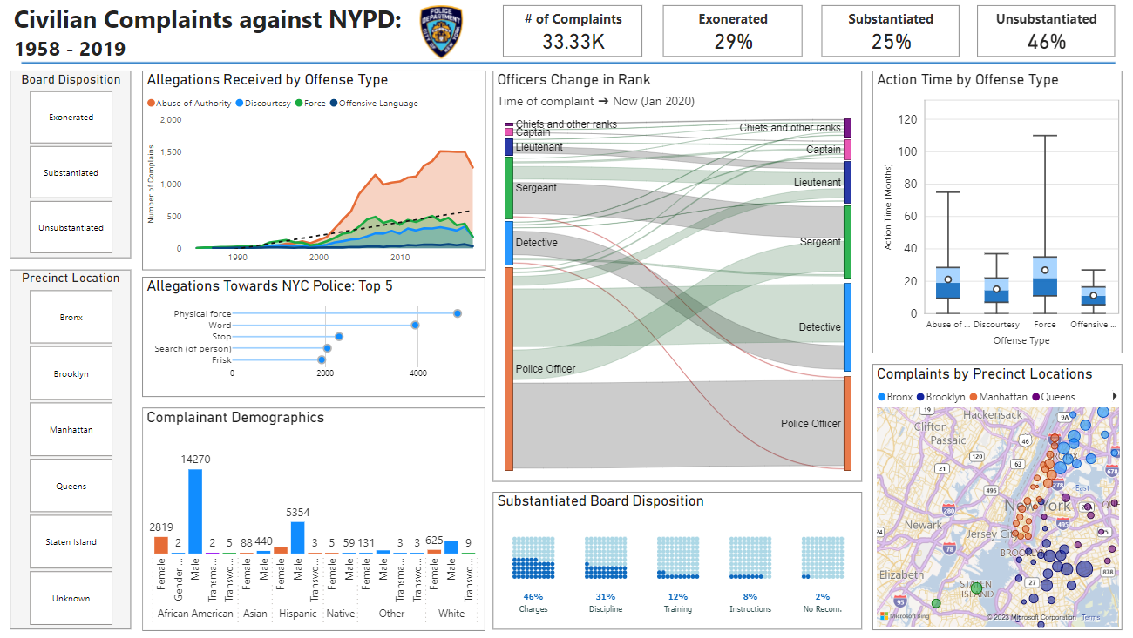

Slide 5

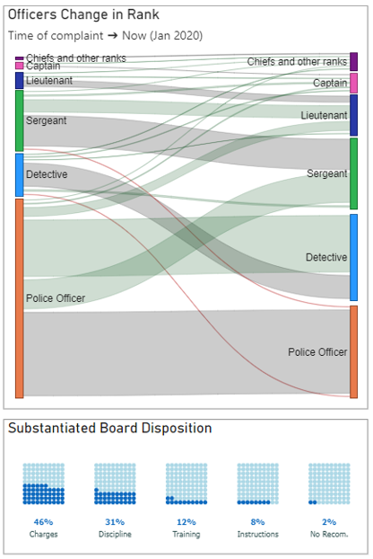
Digital Communications
Officer Change in Rank
Complaint Outcome
Board Outcomes
Substantiated vs Unsubstantiated vs Exonerated
Very little negative change
Large piece charged
Cloud
Local
Hybrid

Slide 6
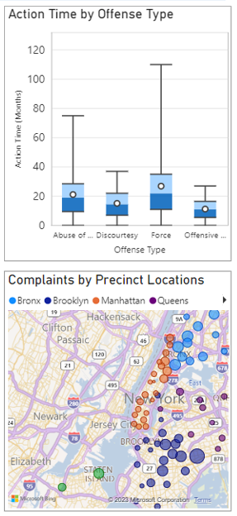
Digital Communications
Action Time
Offense Type
Location
Vast majority of offenses took several years to resolve
Shows a wide range of offenses by officers with force being the longest action time
Based on independently sourced precinct data
Color coded to show boroughs with a high concentration in Brooklyn
Cloud
Local
Hybrid

Slide 7
Model Features
Most Important
Officer age at incident
Officer’s precinct at incident
Year of case close and open
Least Important
Outcome of contact
reason

Slide 8
Model Results
 | precision | recall | f-1 score
accuracy |  |  | 0.87
macro avg | 0.90 | 0.71 | 0.78
weighted avg | 0.87 | 0.87 | 0.87

Slide 9
Conclusion
The data visualizations show some important insights, especially with location and complainant demographic
Random Forest modeling shows impressive ability to predict career change post incident

Slide 10
Future Research
Compare with more robust model types
Look into data from other major cities that could lend perspective to our research

Slide 11

Thank You
lsmith25@bryant.edu

